Slide 1
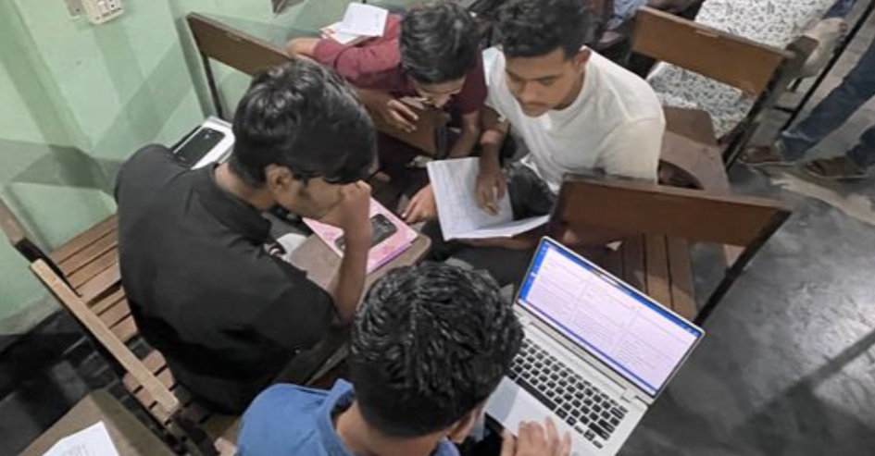
Checking Resources

Slide 2


WA Checking Resources
Translation Notes
Translation Words
Checking for
understanding
Checking for
meanings

Slide 3
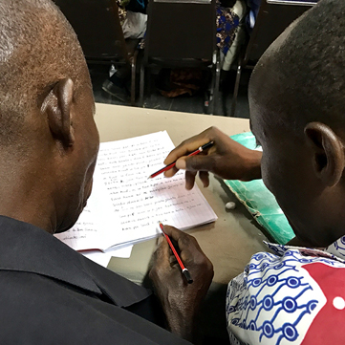
The Steps of MAST
Drafting Steps
Checking Steps
Consume
Verbalize
Chunk
Blind Draft
Self-edit
Peer-edit
Keyword check
Verse-by-verse check

Slide 4
?
Checking Steps
Which resources help with each step?
Self-edit
Peer-edit
Key word check
Verse-by-verse check

Slide 5
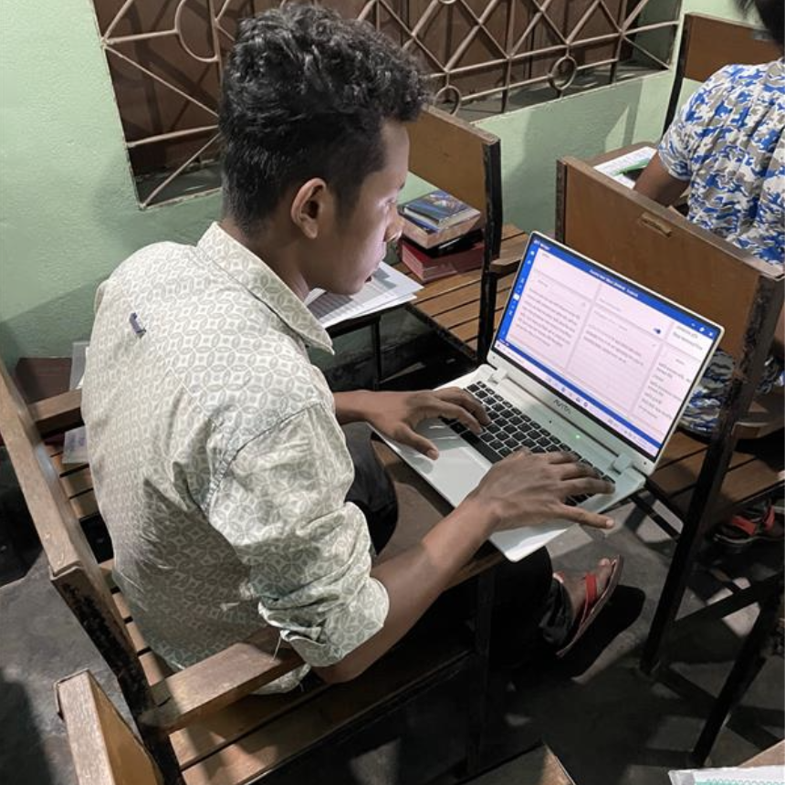


Accessing the Resources
bibleineverylanguage.org
Print out PDFs

Slide 6
Try it
Read Matthew 12:9–14

Slide 7

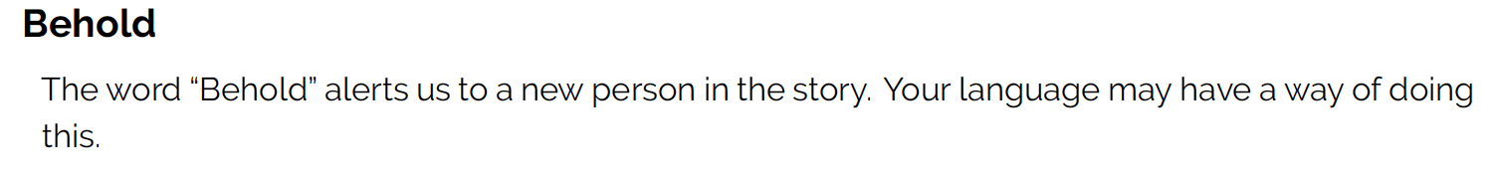

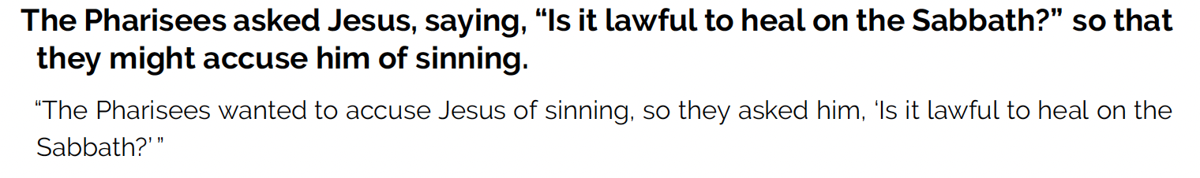

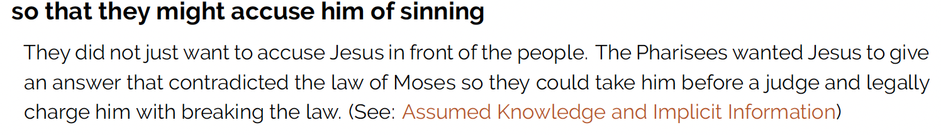
Translation Notes
Try it

Slide 8
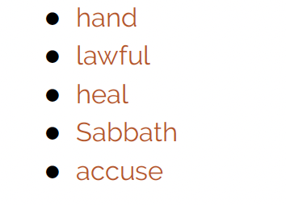
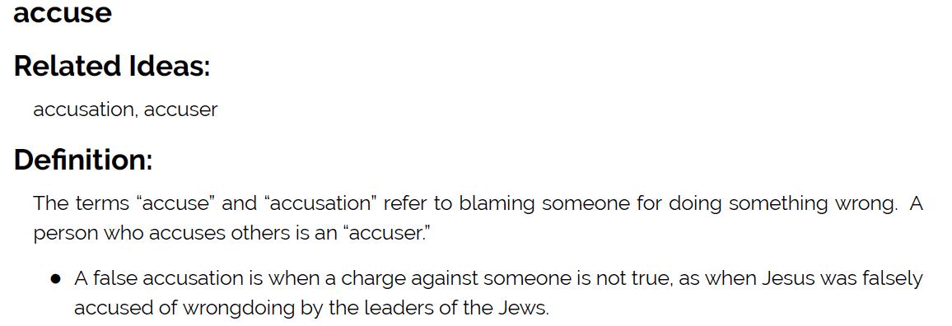
Translation Words
Try it

Slide 9
?
Checking Steps
How would you use these resources with each step?
Self-edit
Peer-edit
Key word check
Verse-by-verse check

Slide 10


